Slide 1
Course - DT228/1
Information Technology Fundamentals
USER CENTREDNESS

Slide 2
Users of Information Systems
A concept of what information systems are;
Information systems are concerned with providing information to support people (e.g. end users) taking actions (such as the tasks of their job).
(End users: very often these are the organisation’s employees.)

Slide 3
Information Systems as Mediators
Another view of what information systems are for is that they mediate between data and the user:
The data is entered into the system, possibly processed, often recorded and often output at a later stage.
The mediation – where the system ‘stands between’ the data and the user who uses them – requires clear analysis and accurate design to produce hardware/software systems that are effective and desirable. (More on that later.)

Slide 4
The End User
A ‘user’ is an individual – a person who uses a computer. This includes expert programmers as well as novices. An end user is any individual who runs an application program.
The end user is the person who uses the hardware or software or system after it has been fully developed and installed.

Slide 5
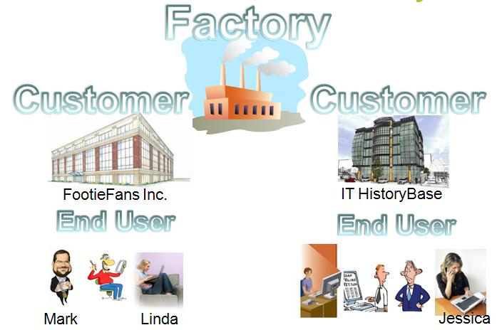
The End User (2)
There are often two types of users; users who require a finished product (end users), and users who may use the same product for development purposes (as in ‘end user computing or end user development).
The term end user usually implies an individual with a relatively low level of computer expertise.

Slide 6
The User Group
A user group is a group of individuals with common interests in some aspect of computers.
Some user groups cover nearly everything with subgroups (called SIGs – Special Interest Groups), while others concentrate on a particular area, such as computer graphics, or a particular application (such as Sage Accounts).

Slide 7
What Does the User Want?
Ask them. Here is a list of possibilities:
Single logon,
A common look-and-feel (interface),
Web access,
Seeing only what they need to do their business,
A guide through the work processes,
To route information electronically when needed,
One place to do all their business,
Information ‘look-up’ when they need it,
To run a report or download data when they need it.

Slide 8
User Interface Analysis
Interface analysis means understanding:
the people (end-users) who will interact with the system through the interface,
the tasks that end-users must perform to do their work,
the content that is presented as part of the interface,
the environment in which these tasks will be conducted.

Slide 9
User Interface Design
Is the user’s new application/system:
Easy to learn?
Easy to use?
Easy to understand?
Golden rules:
Place the user in control
Reduce the user’s memory load
Make the interface consistent

Slide 10
User Interface Design (2)
Typical design errors:
Lack of consistency
Too much memorisation
No guidance/help
No context sensitivity
Poor response
Arcane/unfriendly

Slide 11
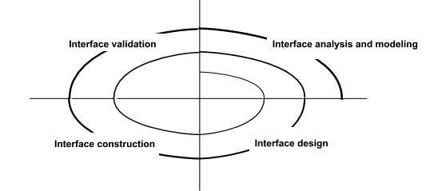
User Interface Design Process

Slide 12
Human-Computer Interaction (HCI)
Human–Computer Interaction (HCI) involves the study, planning, design and uses of the interaction between people (users) and computers.
It is often regarded as the intersection of computer science, behavioral sciences, design, media studies, and several other fields of study.

Slide 13
HCI Design
Rather than the traditional design models adopted within software engineering which are characterised by their linearity.
HCI has adopted a design model which aspires to incorporate the following premises:
user centred
multi disciplinary
highly iterative

Slide 14
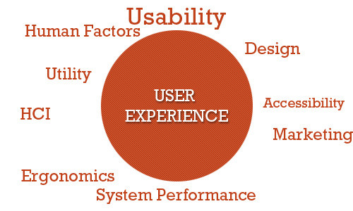
User Centred System Design
User centred system design is based upon a user’s:
abilities and real needs
context
work
tasks

Slide 15
Working Environments
The physical workplace provision has an important effect on individual productivity and satisfaction:
Comfort;
Privacy;
Facilities.
Health and safety considerations must be taken into account:
Lighting;
Heating;
Furniture.

Slide 16
Environmental Factors
Privacy - each engineer or programmer requires an area for uninterrupted work.
Outside awareness - people prefer to work in natural light.
Personalisation - individuals adopt different working practices and like to organise their environment in different ways.

Slide 17
Workspace Organisation
Workspaces should provide private spaces where people can work without interruption.
Providing individual offices for staff has been shown to increase productivity.
However, teams working together also require spaces where formal and informal meetings can be held.

Slide 18
Key Points
Staff selection factors include education, domain experience, adaptability and personality.
People are motivated by interaction, recognition and personal development.
Software development groups should be small and cohesive. Leaders should be competent and should have administrative and technical support.

Slide 19
Key Points (2)
Group communications are affected by status, group size, group organisation and the gender and personality composition of the group
Working environments should include spaces for interaction and spaces for private working.
The People Capability Maturity Model (PCMM or People CMM) is a framework for improving the capabilities of staff in an organisation.

Slide 20
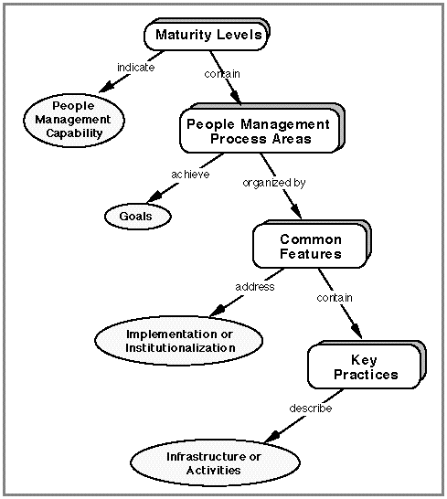
People CMM

Slide 21
Factors, Points and Design
So what? Nice working environment, and other user considerations…
Design of the system may be based on user centredness with importance levels (low to high) driving the system design.
These designs are expected to improve effectiveness, efficiency… company profits.

Slide 22
Back to User Centred Design
This is an approach to interactive system development that focuses specifically on making products/web interfaces usable.
The quality of interaction between the person who uses the product to achieve actual work and the product itself is the primary goal of user-centred design.
User-centred systems empower users and motivate them to learn and explore new system solutions.

Slide 23
User Centred Design
Principles of human-centered design:
Active involvement of users
Appropriate allocation of function between the user and the system
The iteration (repetition) of design solutions
Often there are multidisciplinary design teams

Slide 24
User Centred Design (2)
Essential activities in human-centered design:
Understand and specify the context of use
Specify the user and organisational requirements
Produce design solutions (prototypes)
Evaluate designs with users against requirements

Slide 25
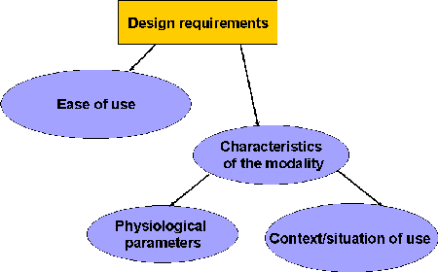
User Centred Design Methodology
The design methodology includes:
the involvement of users throughout the design process
and the use of an iterative design cycle.

Slide 26
User Centred Design Methodology (2)
The methodology has an approach to user interface development and system development.
It focuses on understanding:
Users,
their goals and tasks,
The environment (physical, organisational, social)
Using the method means you pay attention to these throughout development of the system.

Slide 27
User Centred Approach
An early focus on users and tasks: directly studying cognitive, behavioural, anthropomorphic and attitudinal characteristics.
Using empirical measurement: users’ reactions and performance to scenarios, manuals, simulations and prototypes are observed, recorded and analysed.
Iterative design: when problems are found in user testing, fix them and carry out more tests.

Slide 28
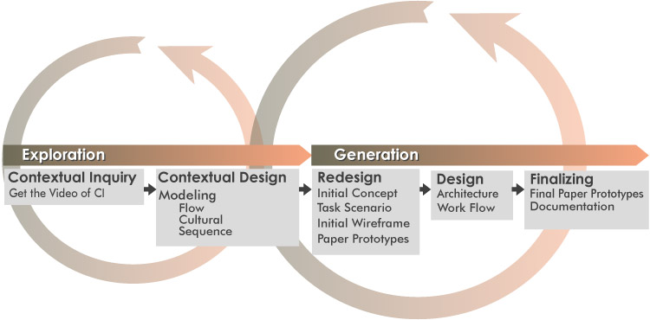
Interaction Design Activities
There are four basic activities in Interaction Design:
Identifying needs and establishing requirements
Developing alternative designs
Building interactive versions of the designs
Evaluating designs

Slide 29
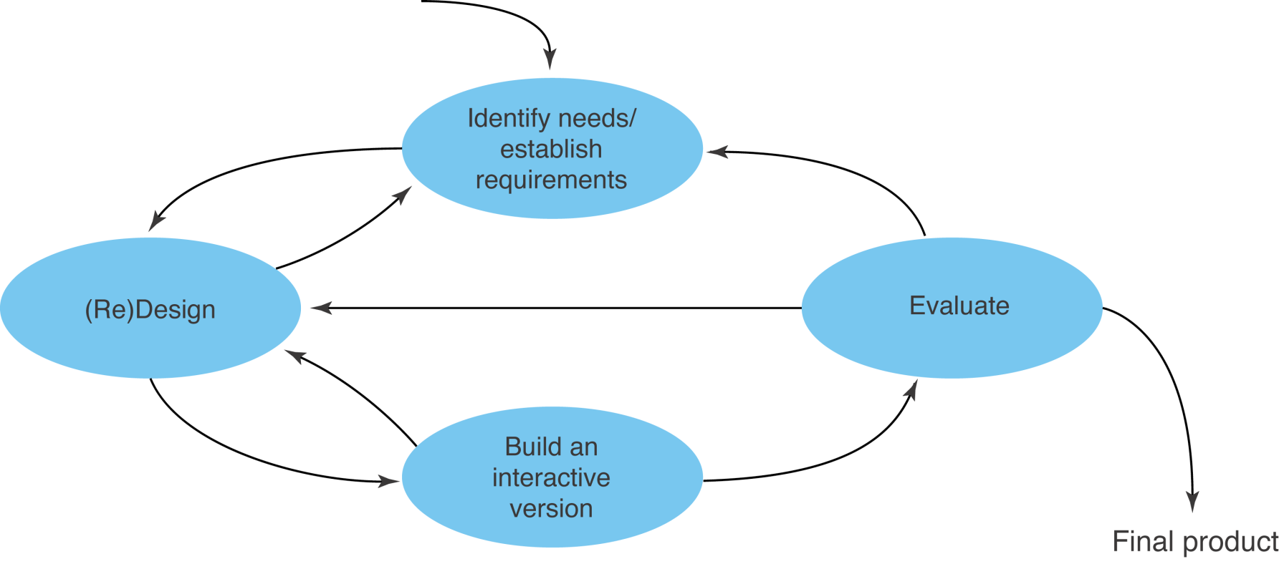
An Interaction Design Model
Exemplifies a user-centred design approach

Slide 30

Practical Issues
Who are the users?
What are their ‘needs’?

Slide 31
Who are the Users/Stakeholders?
This is not as obvious as you might think:
those who interact directly with the product
those who manage direct users
those who receive output from the product
those who make the purchasing decision
those who use competitor’s products

Slide 32
Who are the Users/Stakeholders? (2)
Three categories of user:
primary: frequent hands-on
secondary: occasional or via someone else
tertiary: affected by its introduction, or will influence its purchase

Slide 33
What are the Users’ Capabilities?
Individual differences:
The size of the users’ hands may affect the size and positioning of input buttons
Motor abilities may affect the suitability of certain input and output devices
Height (if designing a stand-up work station)
User strength - a child’s toy requires little strength to operate, but greater strength to change batteries
User disabilities (e.g. sight, hearing, dexterity)
Abilities also vary according to context

Slide 34
What are the Users’ Needs?
Users rarely know what is possible.
Users cannot tell you what they ‘need’ to help them achieve their goals.
It is often up to the systems analyst (or other computing professional) to identify and specify needs.

Slide 35
What are the Users’ Needs? (2)
Look at existing tasks:
their context
what information do they require?
who collaborates to achieve the task?
why is the task achieved the way it is?
Envisioned tasks:
can be rooted in existing behaviour
can be described as future scenarios

Slide 36
User Requirements Data
Common methods used to gather user requirements data:
Interviews
Questionnaires
Observation
Choosing and combining techniques

Slide 37
Interviews for Requirements
Unstructured – where they are not directed by a script. They are ‘rich’ but not replicable.
Structured – where they are tightly scripted, a questionnaire delivered verbally. Replicable but may lack richness.
Semi-structured - guided by a script but interesting issues can be explored in more depth. These can provide a good balance between richness and replicability.

Slide 38
Questionnaires
Questions can be closed or open.
Closed questions are easier to analyse, and may be done by computer.
Questionnaires can be administered to large populations.
Paper, email and the web can be used for dissemination.
Sampling can be a problem when the size of a population is unknown - as is common online.

Slide 39
Online Questionnaires
With online questionnaires:
Responses are usually received quickly.
There are no copying and postage costs.
Data can be collected in a database for analysis.
The time required for data analysis is reduced.
Errors can be corrected easily.

Slide 40
Observation
Direct observation in the field (watching users work). The considerations:
Structuring frameworks for work
The degree of participation (insider or outsider)
Ethnography
Direct observation in controlled environments (such as a ‘test system’)
Indirect observation – such as tracking users’ activities with:
Diaries
Interaction logging

Slide 41
Observation Analysis
Questions around observation analysis might include:
Who is present?
What is their role?
What is happening?
When does the activity occur?
Where is it happening?
Why is it happening?
How is the activity organised?

Slide 42
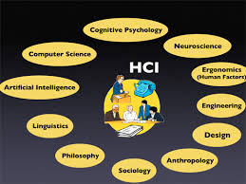
User Centred Domains

Slide 43
Users Can be ‘Central’
In summary: users of computers can and often should be central to systems design.
Thus their systems are expected to be more efficient and usable.
The process of investigation of user-centredness can be expensive for system developers, but there is a pay-off, if done correctly.

Slide 44
Up Next
Week 9’s lecture title is:
Information Technology Professionals

